Slide 1
Deliverable: > A professional 20 minute presentation accompanied by a Google Slide deck that:
1. States the project challenge / challenge space
2. Describes the work conducted
Information gathered and generated
Research methodologies and data analysis techniques deployed
3. Identifies the solution developed and describes key deliverables
4. Articulates a Sustainability Plan (e.g., what would it take to adopt and embed your deliverables)

Slide 2

Brilliant Detroit Event Programming
Alva Claussen, Alexandra Cortez, Bettie Zhang

Slide 3
01
Project background

Slide 4
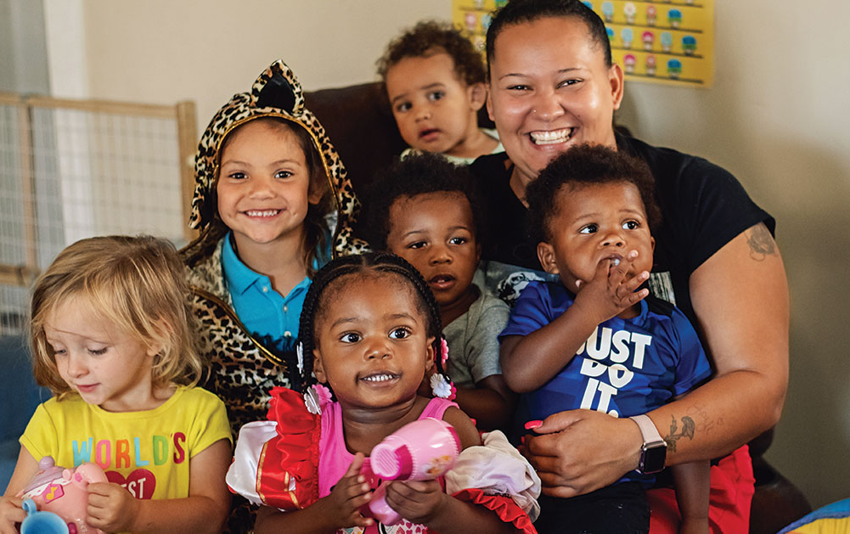
Project background | Who is Brilliant Detroit?
“Dedicated to building kid success families and neighborhoods where families with children 0-8 have what they need to be school-ready, healthy, and stable.”
Notes:
Mission & values
Values include neighbor-led communities, the intellectual, social, and emotional health of families and young children, and evidence-based programs to help improve these areas
They work by evaluating neighborhoods in need. They hold listening session w community members to learn their needs. Then they buy and renovate a home in that area to set up a headquarters for things like a play space, a community garden, and a space to hold programs that advance families.

Slide 5
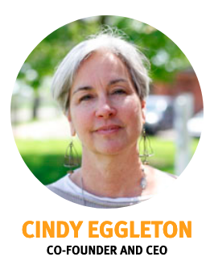
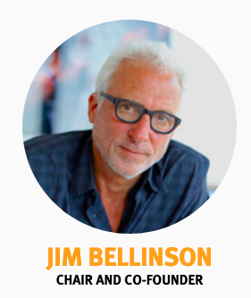
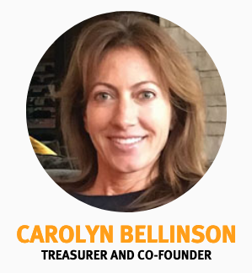

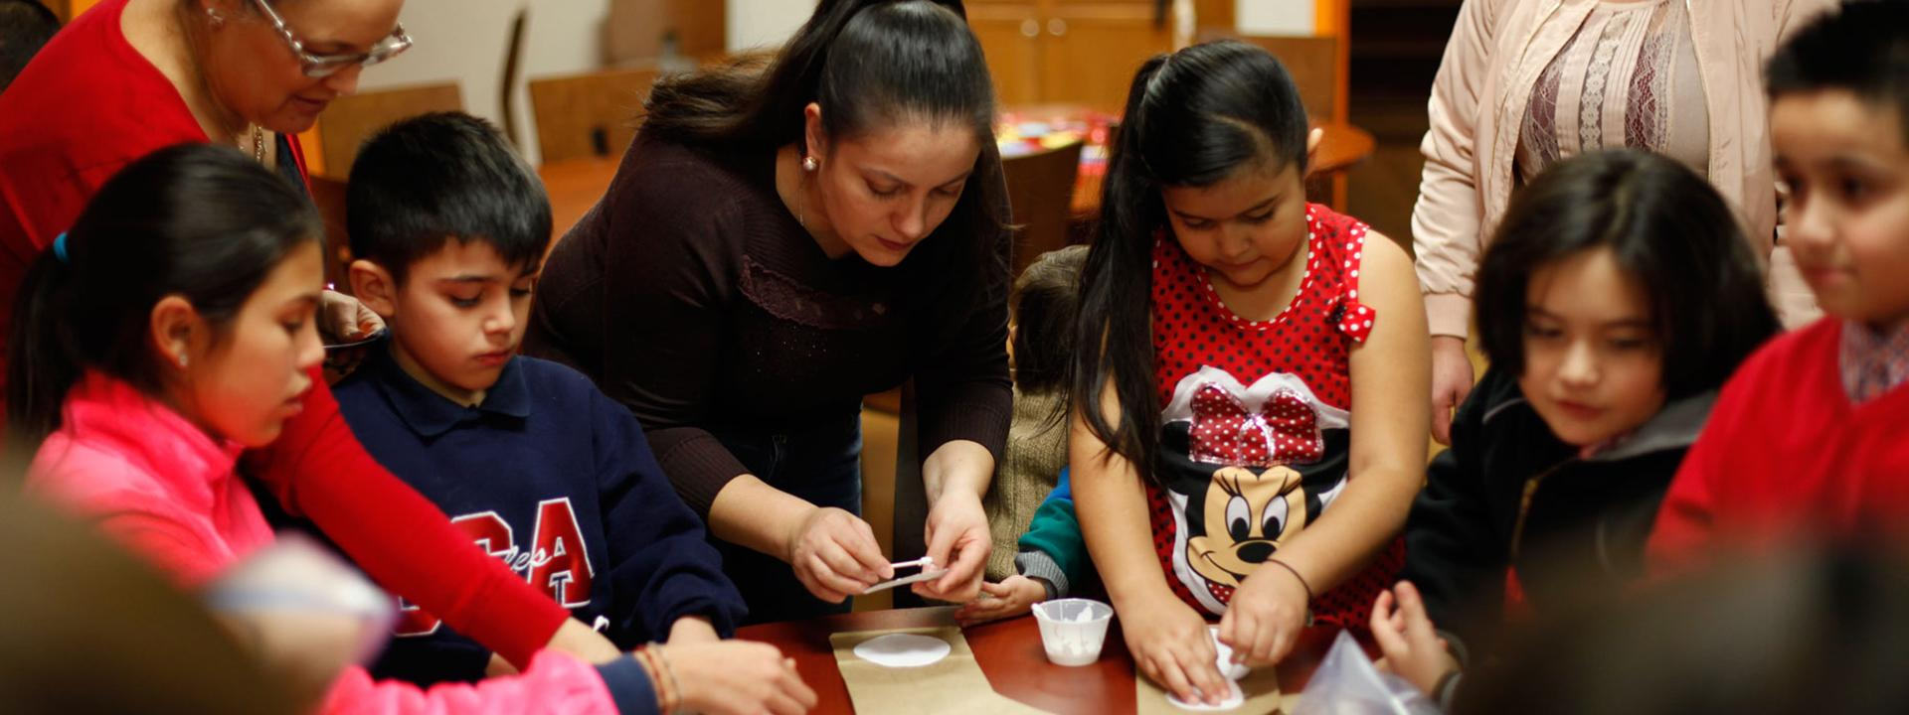
Project background | Who is Brilliant Detroit?
Co-founders Carolyn & Jim Bellinson and Cindy Eggleton meet.
Owns 4 homes serving 3,500+ with 32,000+ hours of services.
Becomes a formal nonprofit and launches Cody Rouge home.
Owns 8 Detroit locations & opening a 9th.
Notes:
History (founding / major milestones)
They’re a fairly young but growing organization. Founded in 2015 when their members met at an Early Childhood Education presentation.
In 2016, they became a formal nonprofit and launched their first house in Warrendale.
By 2018 they had acquired 4 homes and are providing over 3,500 people 32000 hours of services.
Today they own 8 locations and are in the process of opening their ninth.

Slide 6
Who is involved?
Brilliant Detroit is
for neighborhoods,
families, & communities.
The concentration is
on families with kids.
Notes:
Stakeholders & clients

Slide 7
The House’s are staffed by a
Community Engagement Manager
and often a Community Engagement
Coordinator. The organization also
uses a lot of volunteers.
Programs are aimed at making sure
children are up to grade level in reading
by 3rd grade, the secondary focus is in
building healthy communities. The aim
is for educated, healthy, and stable.
Notes:
Staffing & programs

Slide 8
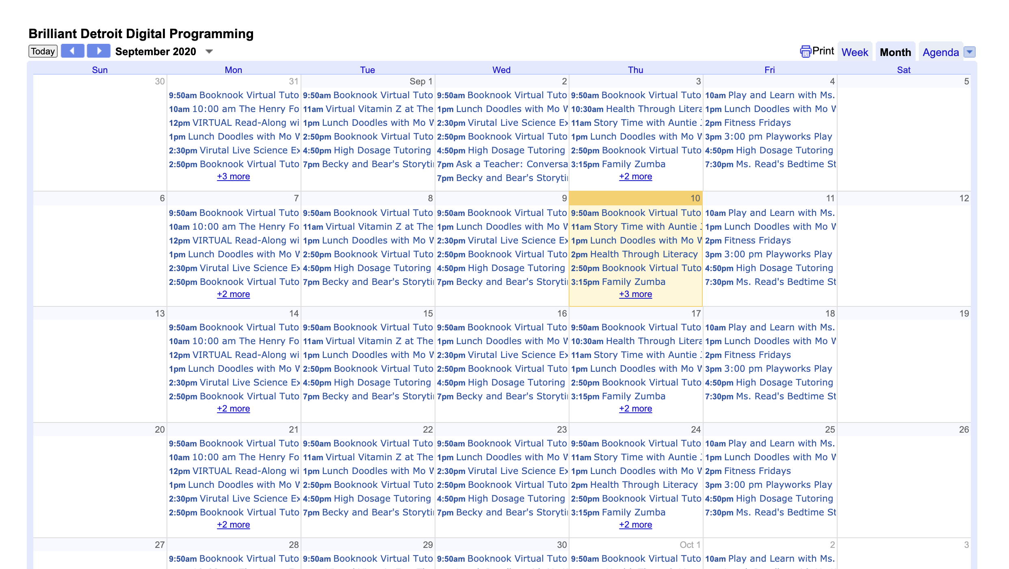
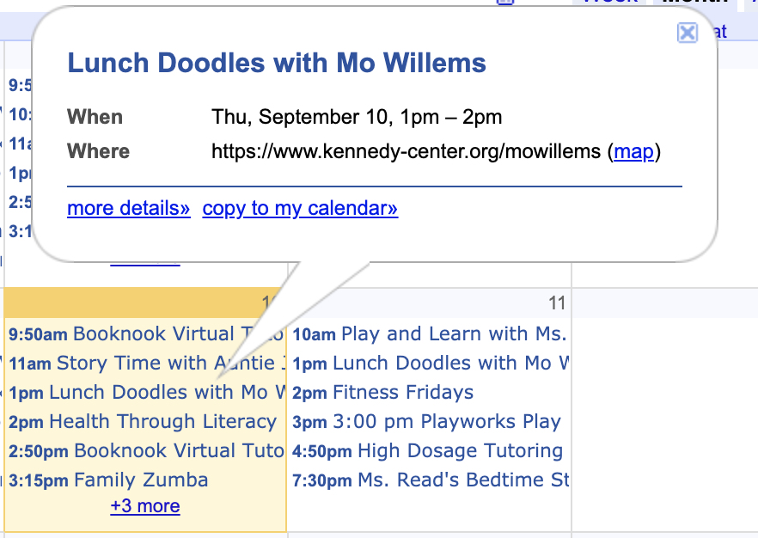
Problem Statement
BD consolidated events one calendar during the COVID-19 crisis.
Events for all site are now all packed into the same calendar.
How might we help participants have a quick and efficient way to get relevant event info in a multilingual context?
Notes:
The current Brilliant Detroit program calendar is packed with event information including virtual and site specific programs with no easy way to distinguish between locations. While BD previously kept separate calendars for each location, this information was difficult to input and was consolidated into one calendar during the COVID-19 crisis. Now that in-person events are beginning to pick up again, How might we help Brilliant Detroit participants to have a quick and efficient way to get relevant event information in a multilingual context?

Slide 9
02
Approach

Slide 10
Approach
Site staff interviews
Participant surveys
Generate requirements
Comparative analysis
Create recommendations
Consider sustainability
Notes:
Our approach to this problem includes first hearing more from stakeholders involved through conducting interviews with site staff as well as creating and distributing surveys to English and Spanish speaking Brilliant Detroit families. From that information, we generated requirements that an event communications solution must satisfy to meet peoples needs.
We then compared existing platforms and solutions in terms of how well they fit requirements and the context of Brilliant Detroit to inform recommendations and a sustainable solutions.

Slide 11
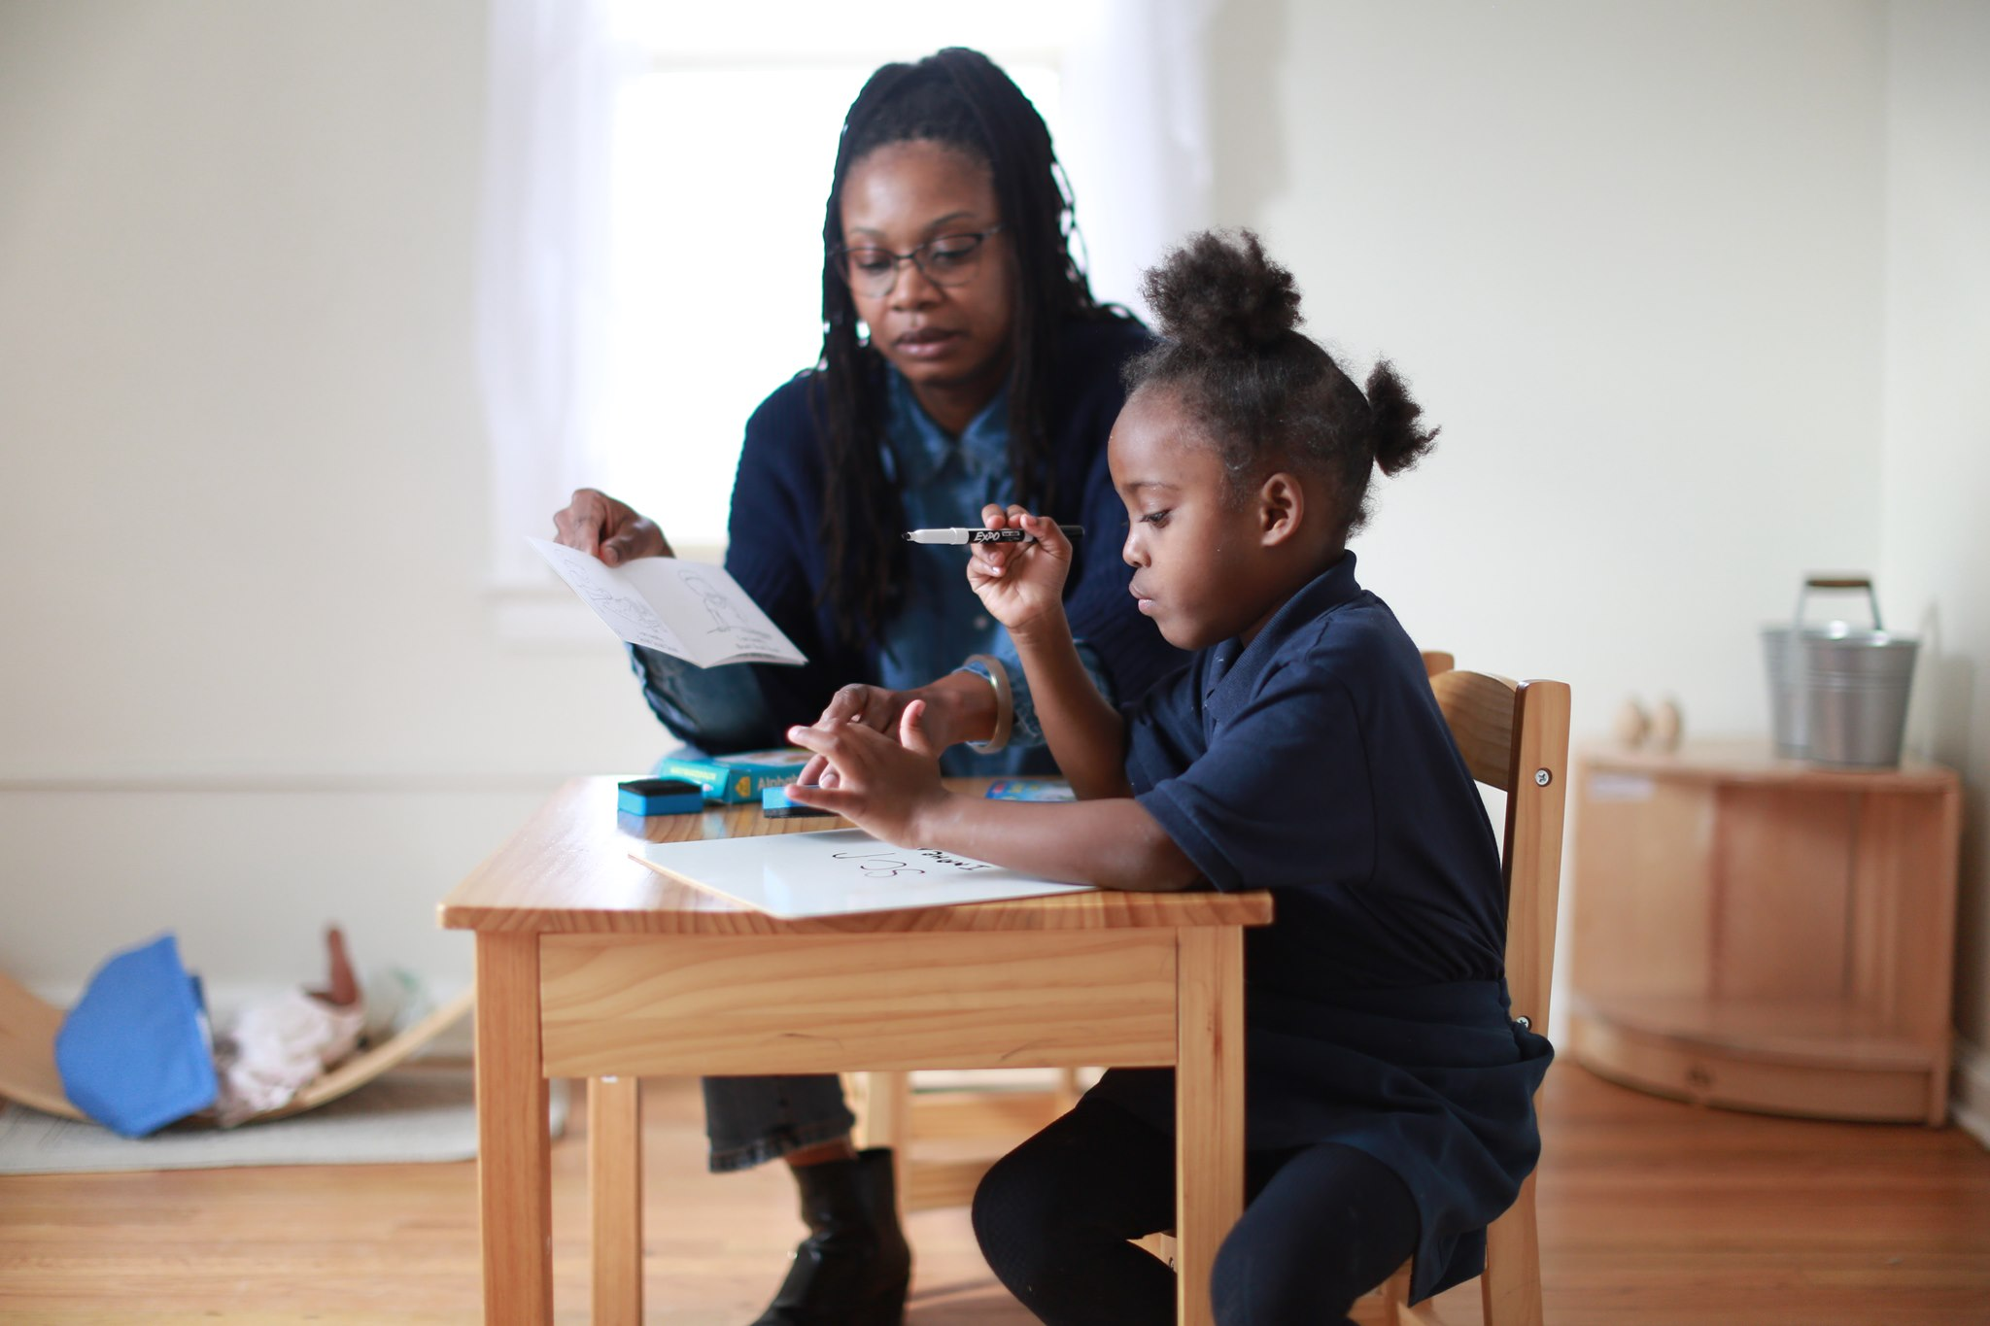
Approach | Interviews
How do site staff currently do event communication?
Interviewed 8 site staff across 4 Brilliant Detroit sites
Analyzed through affinity diagramming
Notes:
Our interviews mainly aimed to answer the question: How do site staff currently communicate event information? We set up meetings with staff from 4 Brilliant Detroit neighborhoods over Google Hangouts to ask them about their experiences through semi-structured interviews.
We chose 4 out of the 8 existing sites in terms of variety of the number of participants, the languages they speak, and the tools they use for event communication.

Slide 12
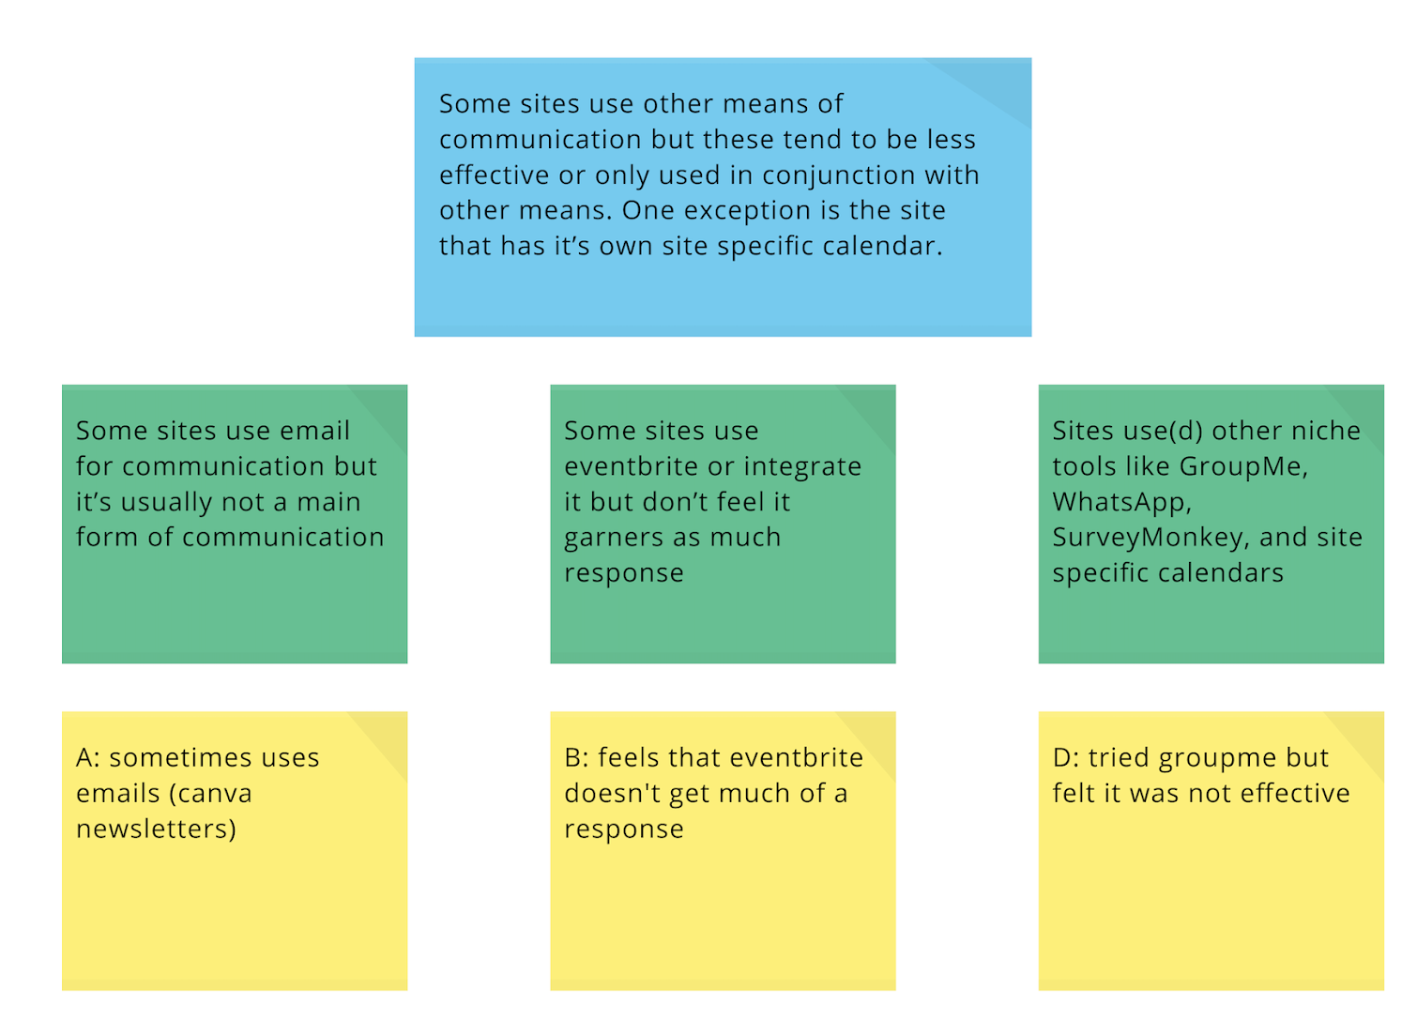
Notes:
To analyze this information, we turned each of our interview notes into affinity notes and then groups similar notes to create insights from site staff.

Slide 13
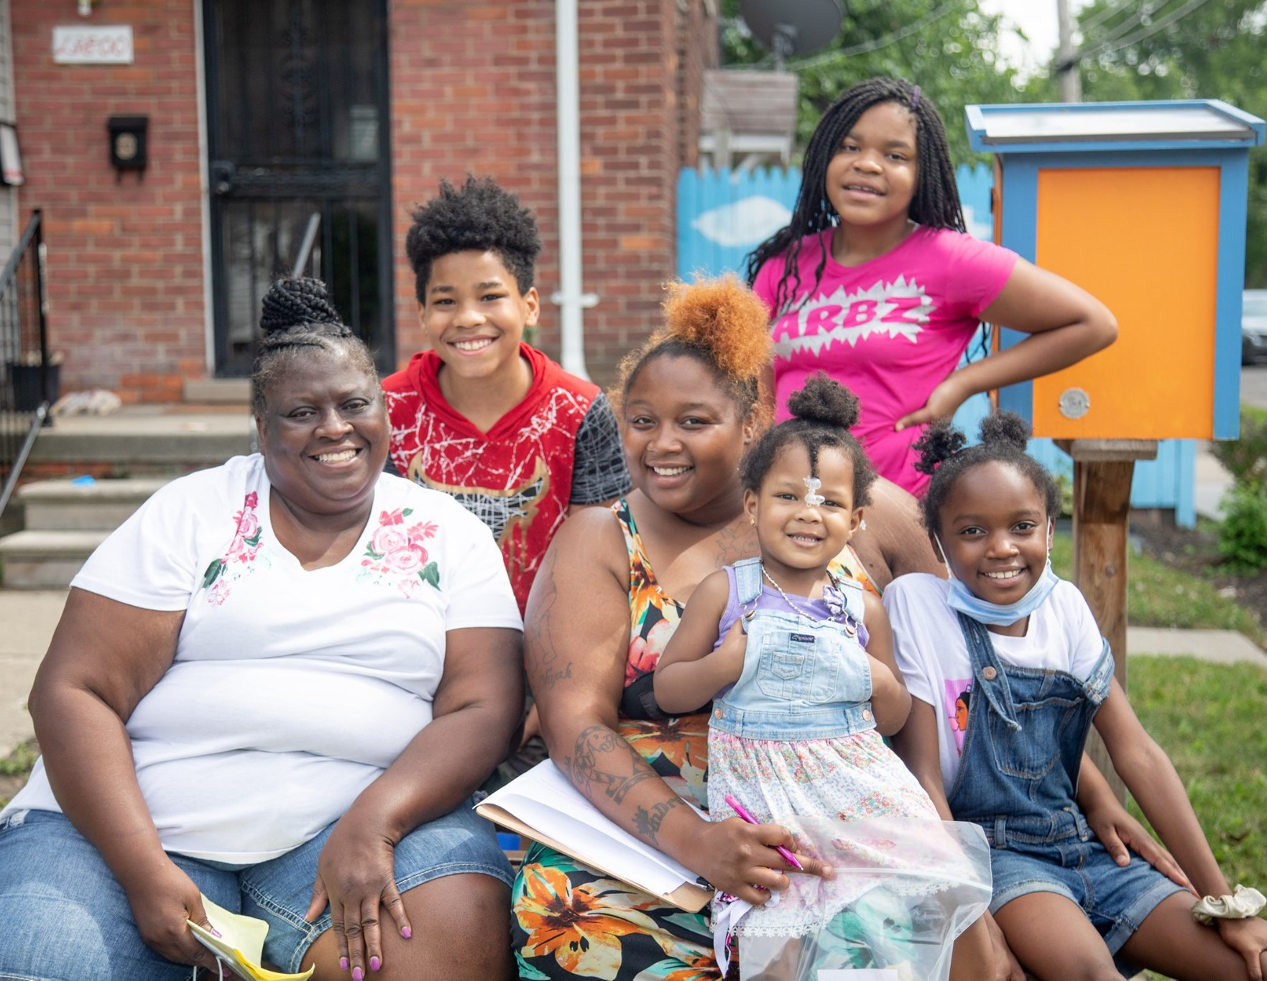
Approach | Participant Surveys
How do participants receive event information?
Spanish & English surveys
Sent to 4 sites
57 responses from 6 sites
Notes:
For the surveys sent out to Brilliant Detroit families, we aimed to answer the question: How do participants receive event information? We created this survey in both spanish and english so every family could have their voice heard. We sent the survey to the 4 sites that we spoke site staff at and received back 57 responses from people who participate in events at 6 different sites.

Slide 14
03
Findings

Slide 15
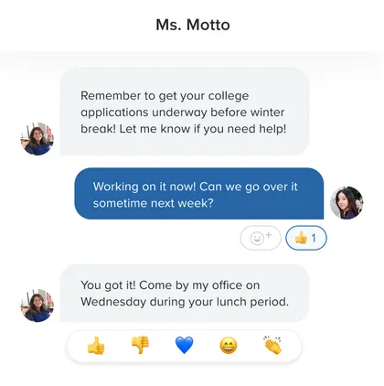
Findings | Interviews
Site staff feel they are doing a good job of event communication individually
Facebook pages may be more relevant than the website
Most sites use Remind, phone calls, and other means of communication
Notes:
When we interviewed site staff we found 3 major takeaways: …
Generally, site staff felt they worked hard so that participants could be well informed and felt like everyone was getting the information they needed in some form, whether that’s through Facebook, text, emails, or face to face.
Since everyone associated event communication strongly with facebook.
In case you’re not familiar with Remind, it’s mobile messaging platform that aims to help teachers, parents, and students, to communicate with each other through messaging. Although it’s typically geared towards schools, Remind enables BD staff to put families into groups based on their interests, send texts to groups about relevant information, and have real time reminders about ongoing events.

Slide 16
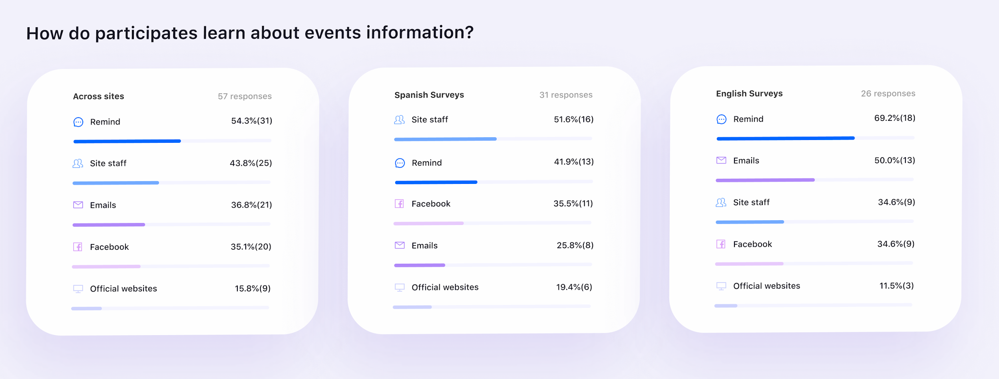
Findings | Participants heavily rely on Remind
Notes:
Despite hearing about the importance of the website from our client contact and the importance of Facebook from many site staff, it turns out that Brilliant Detroit families rely more heavily on Remind. Getting information from site staff closely follows as the next leading source of information because Spanish speakers are more likely to get their information through site staff, as the site staff can give that information in Spanish, while things posted online may not necessarily always be translated.

Slide 17
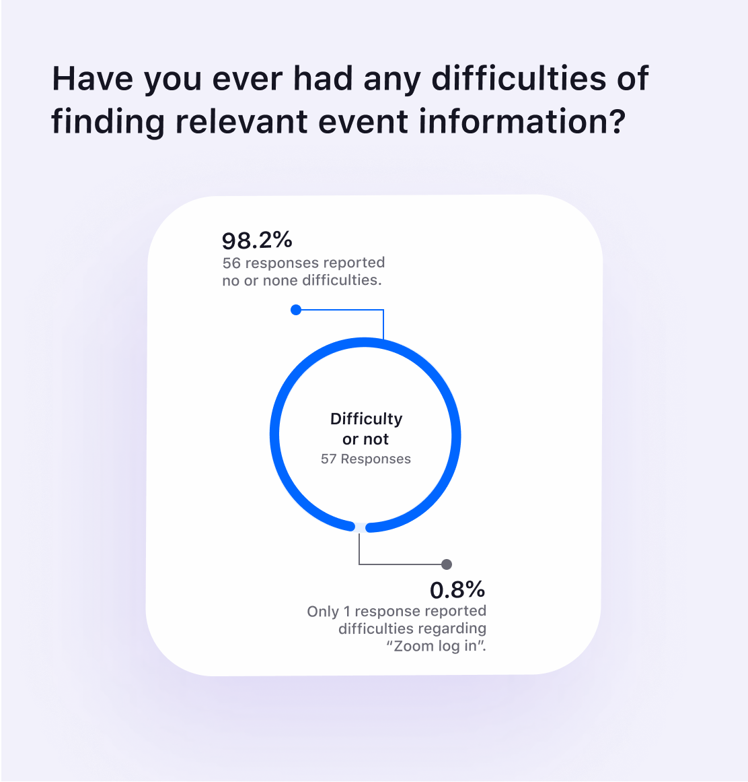
Findings | Participants don’t find it difficult to get information
Notes:
Additionally, 98.2% of participants reported having no difficulties in finding relevant event information, except for one person who cited difficulties regarding logging on to Zoom to attend an event towards the beginning of the pandemic. This felt like verification to what site staff had told us earlier about feeling like their participants are generally well informed about things.

Slide 18

Findings | Gratefulness for Brilliant Detroit support
Notes:
Lastly, there was an overwhelming sense of support for the work that Brilliant Detroit does in these neighborhoods. Many people value the sense of community and support that BD brings to their neighborhoods. Spanish-speaking participants deeply value the learning opportunities like English classes. Others mentioned appreciation for general support, the friendly staff, resources, and a connection to the community.

Slide 19
Findings | Requirements
Solutions for event communication should:
Avoid repeated work
Be easily integrate
Be accessible to everyone
Have translation options
Employ filters
Notes:
We analyzed and condensed these findings down into 5 requirements that a solutions for event communication should entail.
Avoid repeated work. Sites already have a number of tools they are using to communicate with participants, some of which are utilized more than others depending on the site. The solution should avoid having the already busy site staff enter the same information on multiple platforms.
Be easily integrated. The solution should capitalize on what is already working well on different platforms for many sites. Since the Brilliant Detroit site is hosted on WordPress, the solution must also be able to be integrated in some form on a WordPress website.
Be accessible to everyone. Participants have different preferences for receiving information. Not all participants are on social media regularly. The implemented solution should allow participants to access information without further cluttering their information environment. Also, the vast majority of participants use their cell phone to find and participate in events, so BD should make sure to consider a mobile first approach.
Have translation options. This is more of a nice to have but, For sites that have a larger number of Spanish-speaking participants, site staff are currently doing “translation work” through their person to person conversations with participants. It would be nice for that to be shared in a cohesive and consistent way across event information.
Employ filters. One of site staff top concerns is overwhelming participants with too much information. While participants currently feel they are well informed, it’s important to make the process of event information seeking as easy and tailored as possible. Filters or tags will enable participants as well as others who are seeking out information to quickly find the type of events they’re looking for.

Slide 20
04
Recommendations

Slide 21
Recommendations | Key Features
Criteria
Mobile
Well supported
Practical
Changing

Slide 22
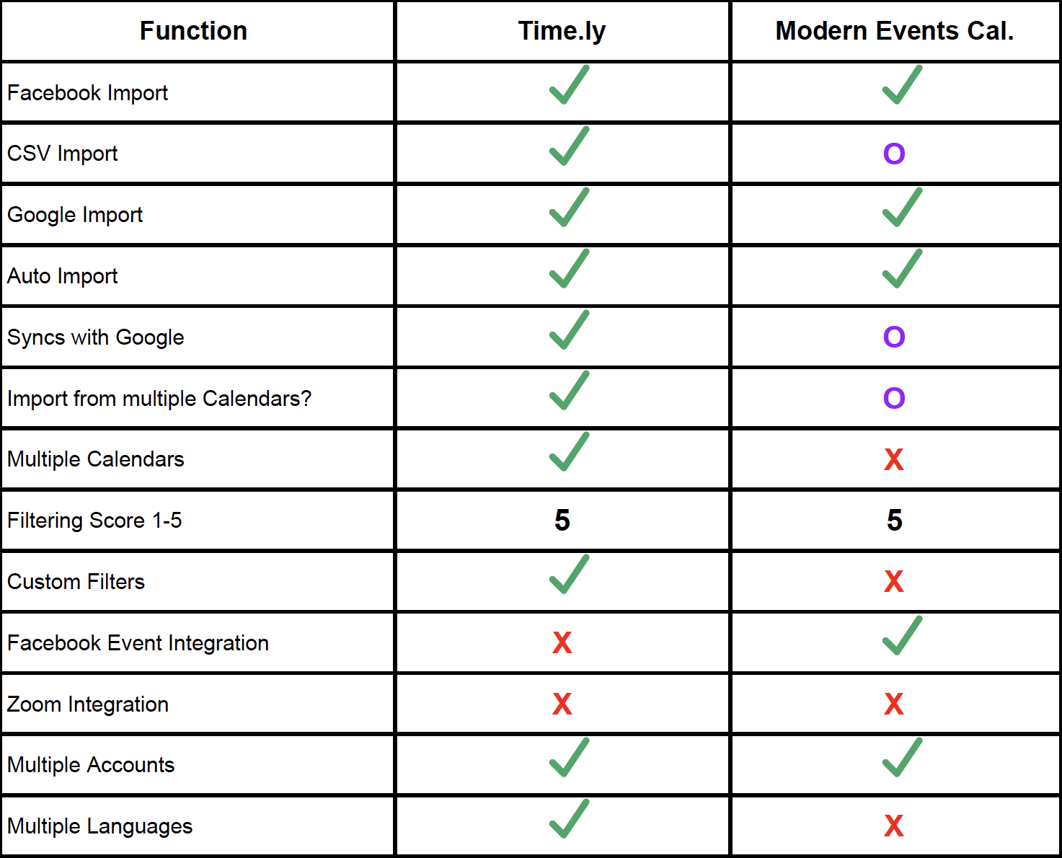

Slide 23
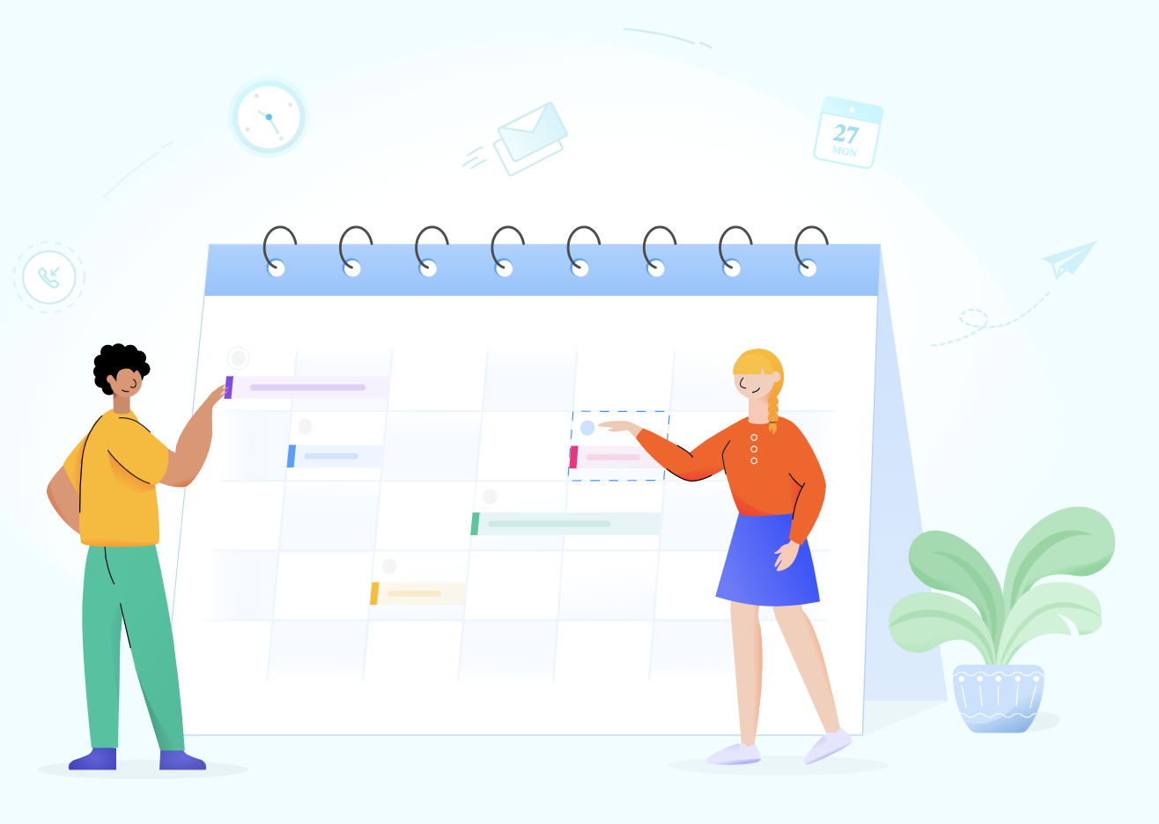
Modern Events Lite
FREE

Slide 24
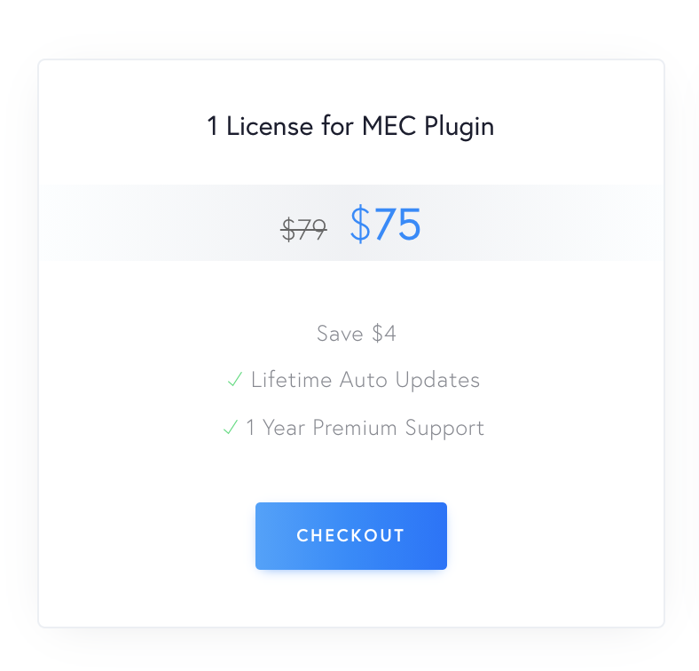
Modern Events Pro

Slide 25
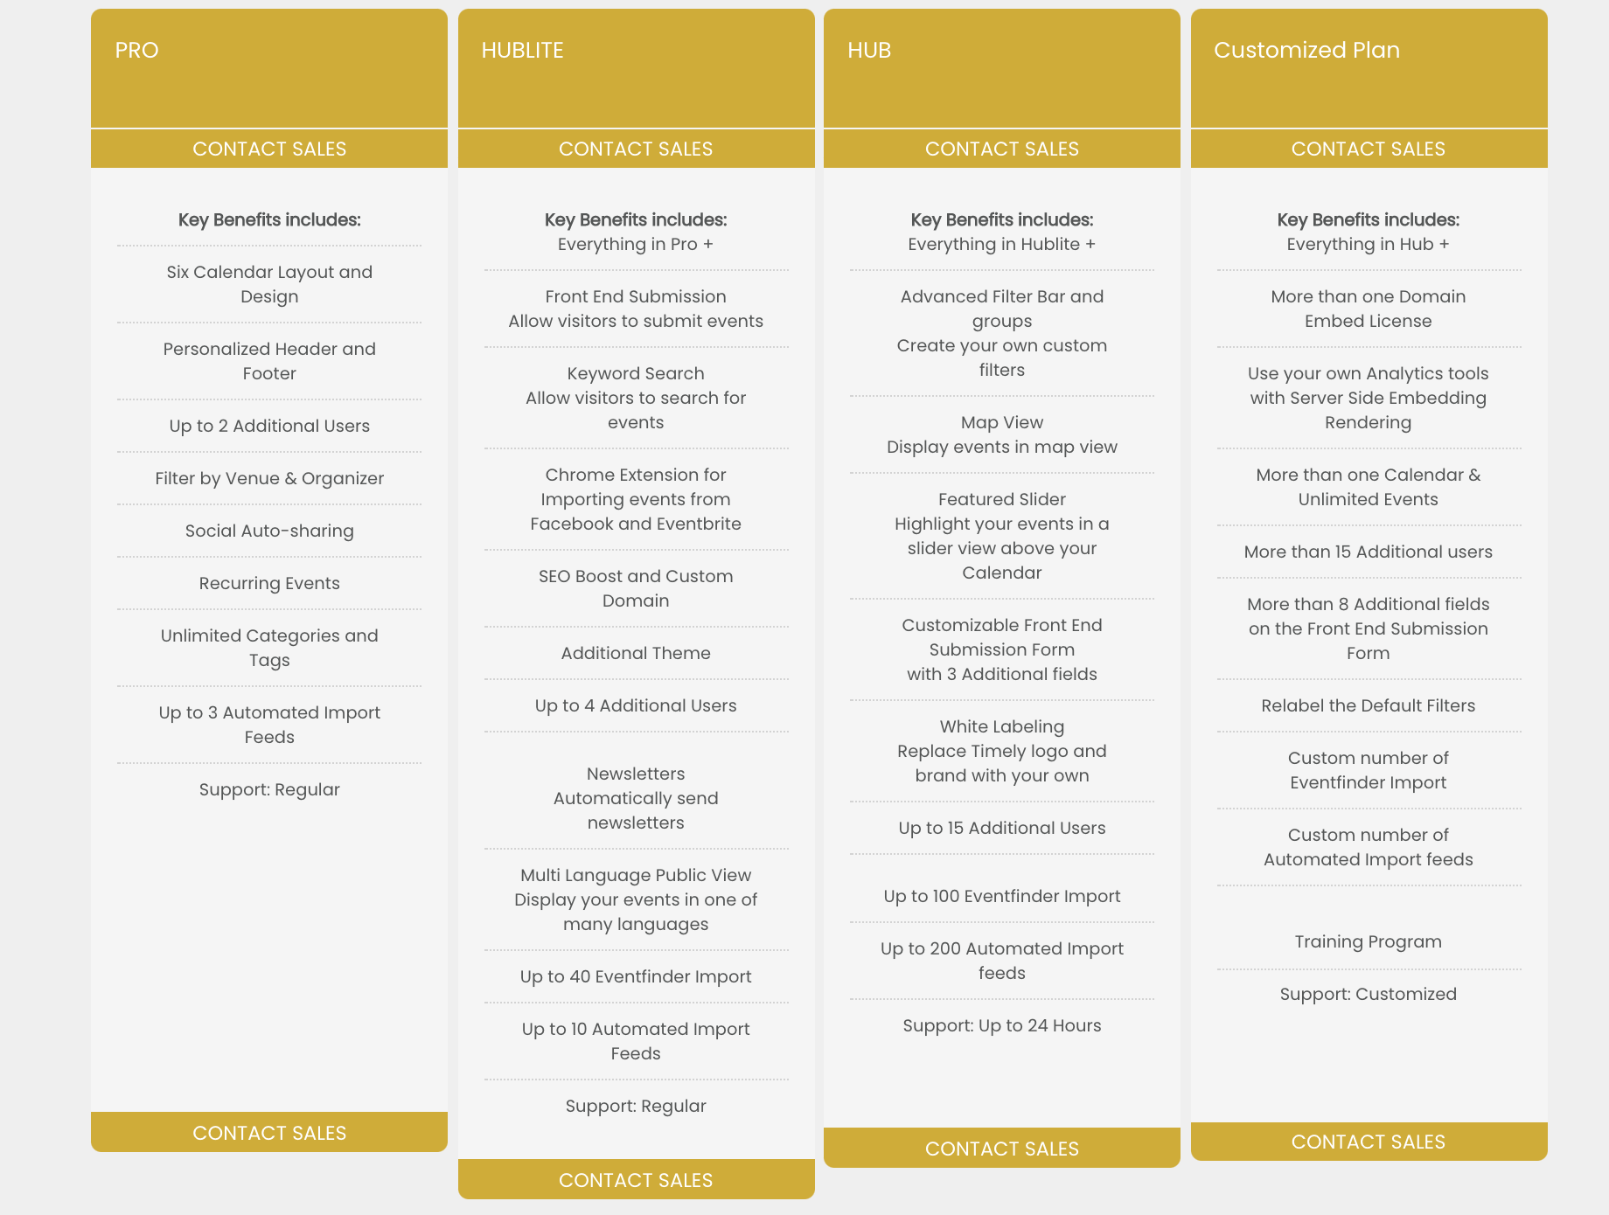
Time.ly Journey

Slide 26
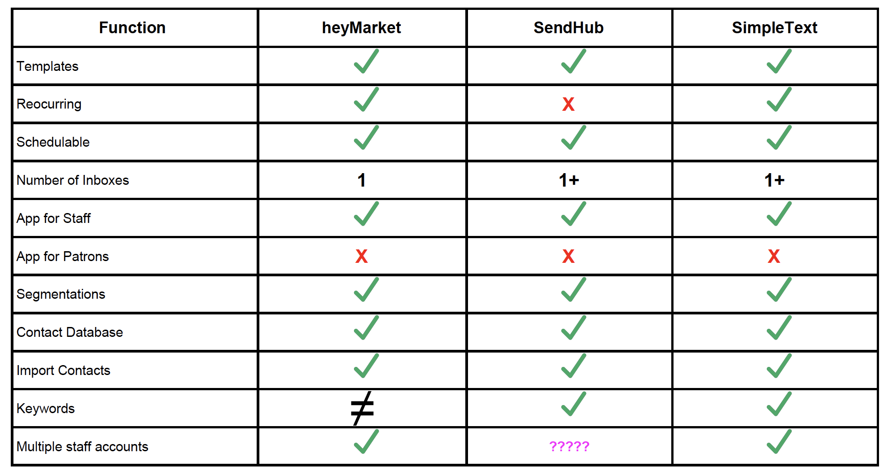

Slide 27
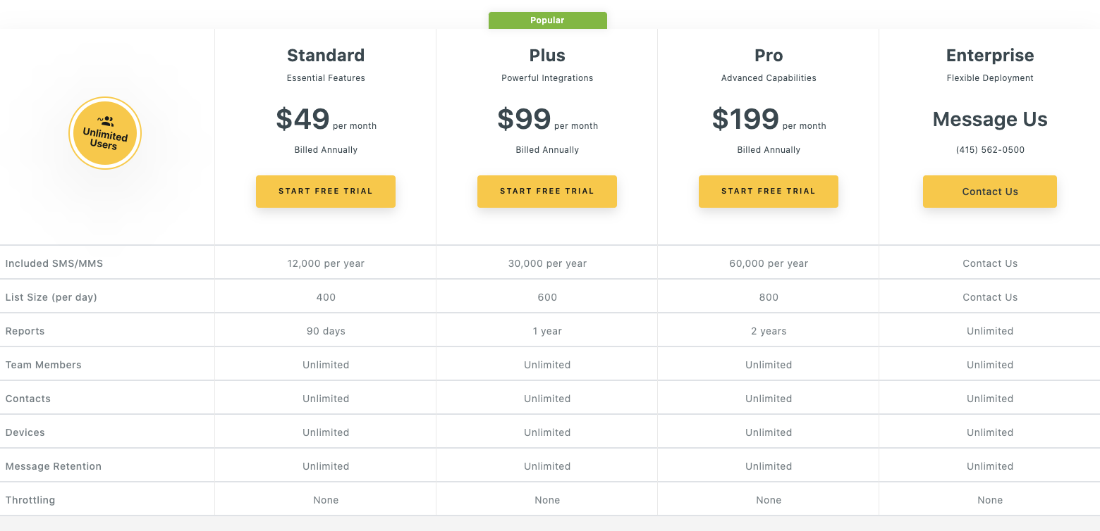
heyMarket

Slide 28
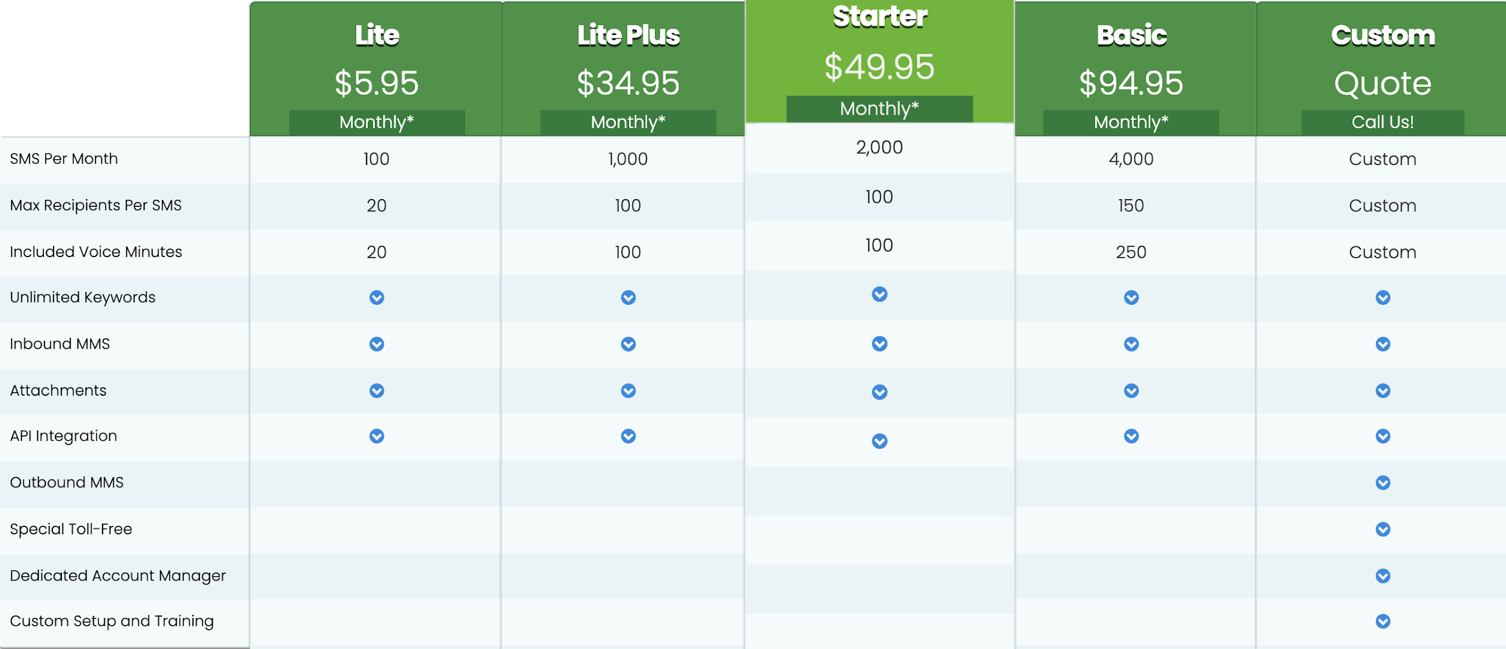
SendHub

Slide 29
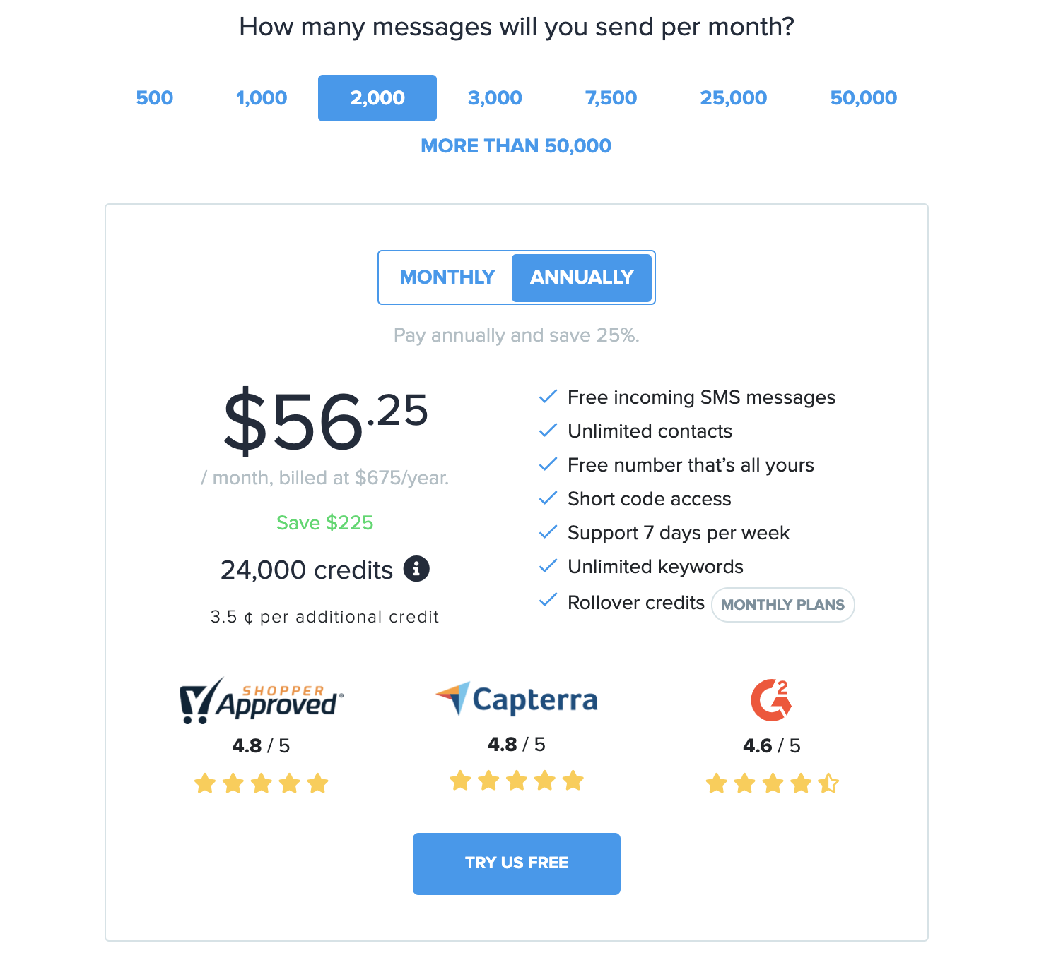
Simple Text

Slide 30
05
Next Steps & Sustainability

Slide 31
Next Steps | Calendar
Poll staff about features
Look at demos
Try the free version of Modern Events and decide if it is enough
If not try Modern Events Pro or Time.ly

Slide 32
Next Steps | Messaging Communication
Poll employees
Request a demo
Decide if you want a free trial
Evaluate pricing
Pick a plan

Slide 33
Sustainability
Keep doing what you are doing
Keep evaluating staff and patron needs
Keep Chelsea & Zak in charge of this project

Slide 34
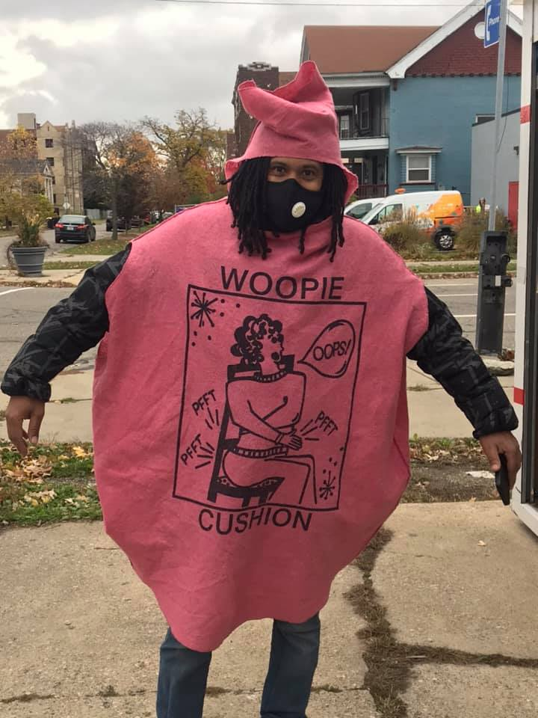
Thank you
Questions?

